Slide 1
App Service Web Apps
Notes:
One of the most common things that people do in the cloud is running websites and web applications
Once a website is running, you can add or remove instances dynamically, relying on Azure Websites to load balance requests across them.
WebSites will be your choice in 99% of the time
Cloud Services was the only option before WebSites

Slide 2
Agenda
Web App creation
Language Support
Deployment
Source Control Integration
Scale
Web Jobs
Site Slots
Traffic Manager
Backup
Hybrid Connections
Redis Cache

Slide 3
Azure App Service

Slide 4


Azure App Service Build and scale great cloud apps
Web Apps
Mobile Apps
Logic Apps
API Apps

Slide 5
App Service - one integrated offering
Web Apps
Mobile Apps
Web apps that scale with your business
Build Mobile apps for any device
LOGIC Apps
API Apps
Automate business process across SaaS and on-premises
Easily build and consume APIs in the cloud

Slide 6
Develop apps with…
.NET | Node.js | PHP | Python | Java
Notes:
Websites supports .NET, PHP, Node.js, Java and Python along with SQL Database and MySQL
It also provides built-in support for several popular applications, including WordPress, Joomla, and Drupal.
The goal is to provide a low-cost, scalable, and broadly useful platform for creating websites and web applications in the public cloud.
Use an open-source app from the Web Application Gallery, or create a new site using the framework and tools of your choice.

Slide 7
Benefits of App Services
Automatic OS patching
Enterprise-grade security
High availability
Automated scale out/in
Built-in load balancing
Supports many languages and platforms
.NET, Node.js, Python, Ruby and many more
Easy continuous deployment
Continuous delivery from third-party source control providers
Built-in Git repo

Slide 8



Web Apps
Logic Apps
Mobile Apps
Administration App
Customer site
Order Completed
Customer App
http
SQL
API Apps

Slide 9
Web Apps

Slide 10
Full capability set available including:
.NET, Node.js, Java, PHP, and Python
WebJobs for long running tasks
Integrated VS publish, remote debug…
CI with GitHub, BitBucket, VSO
Auto-load balance, Autoscale, Geo DR
Virtual networking and hybrid connections
Site slots for staged deployments
Web Apps
Web apps run as-is
no changes required

Slide 11
App Service Web App
Web Site
Monaco
MSDeploy
Build/Upload Your Own
Kudu
Web Jobs
Gallery
Public Site Extensions
Private Site Extensions
Azure App Service Web App

Slide 12
Demo: Creating a Web App
Notes:
Web Hosting Plans
Shared Instances
Reserved Instances
Multiple DEDICATED compute instances
SSL Certificates
SLA 99.9%

Slide 13
App Service Web App Architecture
Deployment
Server(s)
File Server
Publish Endpoint
Blob Storage
Application Database
Frontend (IIS ARR)
Microsoft Azure
Load Balancer
Metering
Runtime Database
API Endpoint

Slide 14
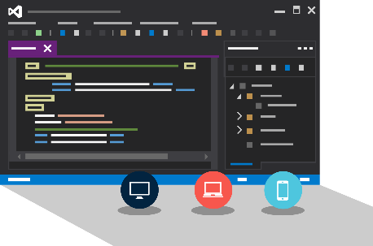
Visual Studio + App Service Web Apps
Create Azure Resources during File / New
Create Web App during deploy
Manage with Server Explorer

Slide 15
Continuous Delivery with App Service

Slide 16
Continuous integration

Slide 17

Continuous Deployment for Web Apps
Web App Production Slot
Agility through Continuous Deployment
Auto-Swap
Hooks
Git pull
Commits
Changes
Source Control / Code Repo
Developer
Web App Staging Slot

Slide 18

Source Control for Web/API/Mobile Apps
Git
Visual Studio
Online
CodePlex
GitHub
BitBucket
Dropbox
FTP
Choose your own adventure!
Notes:
Slide Objectives:
Objective #1
Transition:
Transition statement(s) to setup the slide
Speaking Points:
Speaking Point #1
Speaking Point #2
Notes:
Any notes go here

Slide 19
AutoScale
Notes:
You cannot scale a Free website; it is restricted to one instance.
You can scale a Basic website manually up to three instances.
For autoscaling, you must use a Standard website, which allows up to 10 instances
Scale according to a schedule
Scale by CPU Percentage usage

Slide 20

AutoScale
Web App

Slide 21
AutoScale
Web App

Slide 22
AutoScale
Web App

Slide 23
Site Slots

Slide 24
Staging

Slide 25
Staging

Slide 26
Staging

Slide 27
Staging

Slide 28
WebJobs

Slide 29






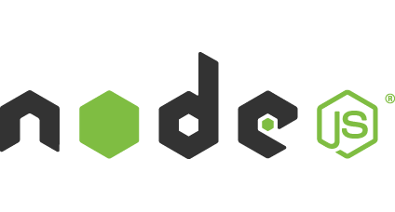

Light-weight CPU Intensive Tasks
run.cmd, run.bat
run.exe
run.ps1
run.sh
run.php
run.py
run.js
Job Type:
On-Demand, Scheduled, Continuous
Scale:
Singleton, Multi-instance
WebJobs SDK Feature:
BlobTrigger, TableTrigger, QueueTrigger, ServicebusTrigger
Deployment:
Portal, Visual Studio, CLI, Git

Slide 30
WebJobs
Web App

Slide 31
WebJobs
Web App

Slide 32
Demo: WebJobs

Slide 33
API Apps

Slide 34
Easily use cloud or custom APIs:
Dozens of built-in APIs for popular SaaS
An ecosystem of APIs for any need
Create and publish custom, reusable APIs
Visual Studio tooling with one click publish and remote debugging
Automatic client SDK generation for many languages
Api Apps
Create, consume and
host APIs more easily

Slide 35
Benefits of API Apps
Bring your API as-is
.NET Web API
Node.js + Express
Java
PHP
Many other technologies
Connect easily to SaaS platforms

Slide 36
API Apps addresses key pains around building and consuming APIs
Build your API
Consume APIs
Web Apps++: Bring you API as is in your language of choice
API discovery
SDK generation
SSO, handled by server
Authentication, built-in to mobile and web SDKs
Expose enterprise APIs
Microservice style
Metadata contract
SSO
Simple access control
Gallery – public & organization

Slide 37
Demo: Creating an API App

Slide 38
Consuming API Apps
API Apps expose HTTP services
Metadata is exposed using Swagger 2.0 metadata
JSON file
Widely supported
Client applications

Slide 39
Enterprise connectivity
Dynamics
SQL
SAP
Oracle

Slide 40




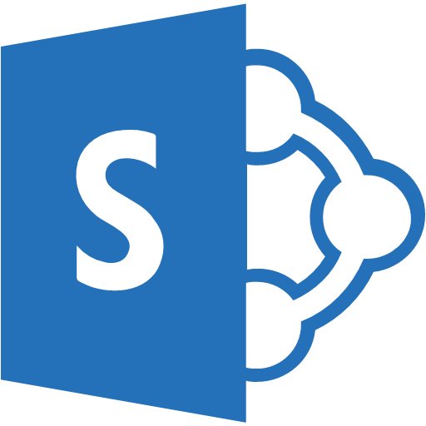

Simplifying Integration
Managed Middle Tier
API App[s]
On Premise Applications
Databases in Azure VMs
SharePoint Online
Cloud-Hosted Web Apps
SSO, Auth, Scale, etc.

Slide 41
Logic Apps

Slide 42
New Logic Apps for easy automation
No code designer for rapid creation
Dozens of pre-built templates to get started
Out of box support for popular SaaS and on-premises apps
Use with custom API apps of your own
Biztalk APIs for expert integration scenarios
LOGIC Apps
Automate SaaS and
on-premises systems

Slide 43
SaaS integration

Slide 44
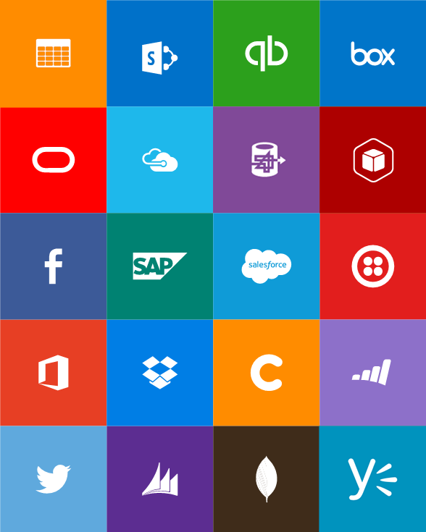
Built-in API Connectors
Connectors
Box
Chatter
Delay
Dropbox
Azure HD Insight
Marketo
Azure Media Services
OneDrive
SharePoint
SQL Server
Office 365
Oracle
QuickBooks
SalesForce
Sugar CRM
SAP
Azure Service Bus
Azure Storage
Timer / Recurrence
Twilio
Twitter
IBM DB2
Informix
Websphere MQ
Azure Web Jobs
Yammer
Dynamics CRM
Dynamics AX
Hybrid Connectivity
Protocols
BizTalk Services
HTTP, HTTPS
File
Flat File
FTP, SFTP
POP3/IMAP
SMTP
SOAP + WCF
Batching / Debatching
Validate
Extract (XPath)
Transform (+Mapper)
Convert (XML-JSON)
Convert (XML-FF)
X12
EDIFACT
AS2
TPMOM
Rules Engine

Slide 45
Target audience is anyone who can use Azure
… but not necessarily business users or consumers

Slide 46
Mobile Apps

Slide 47
New capabilities for Mobile apps:
Webjobs for long running tasks
CI with GitHub, BitBucket, VSO
Auto-load balance, Autoscale, Geo DR
Virtual networking and hybrid connections
Site slots for staged deployments
Mobile Apps
Mobile services plus
a whole lot more

Slide 48







Azure Mobile Services
Storage
Authentication
Logic
Push
Scheduler
Notes:
Speaking Notes
Summarize earlier slide
Azure Mobile Services is a Backend-as-a-Service
Instead of you having to design, build, test, deploy, manage, and upgrade your whole backend, we do it for you
Features of Mobile Services
Storage – SQL DB
Authentication – built in support for social providers w/ ability to custom auth
Backend logic – data validation, logical flows, etc
Push Notifications – across all major mobile platforms
Scheduler – backend job processing

Slide 49
Structured Storage
Powered by SQL Database
Supports rich querying capabilities
Dynamic Schematization
Data management in:
Azure Portal
SQL Portal (Silverlight)
SQL Management Studio
REST API
Azure CLI Tools
SQL CLI
Microsoft Azure
Notes:
Speaking points
Mobile Service easily connects to SQL Database
SQL offers rich querying and indexing capabilities
Dynamic Schematization means you don’t have to be a DBA and manage schema
Data can be managed in:
Azure Portal (read and delete data)
SQL Portal (Silverlight)
SQL Management Studio (windows)
REST API (used by SDKs)
Azure CLI tools
SQL CLI (Node module)

Slide 50
Server Side Table Scripts
Node.js scripts
.NET Web API
backend in
Visual Studio
Passes through to SQL by default
MongoDB, Table Storage, SQL out of the box
Intercept CRUD requests to tables
Fully customizable
Notes:
Speaking points
Node backend generates Node scripts for each table action
Scripts intercept CRUD requests
Pass to SQL by default
Custom logic added here
Edit in portal (NODE)
.NET Backend creates Visual Studio project

Slide 51
Demo: Basic Mobile App with Validation

Slide 52
Custom API
Non-table based endpoints
Accessible from
GET
POST
PUT
PATCH
DELETE
For node.js logic in scripts like table endpoints
For .NET delivered through a WebAPI
Expose any functionality you want
Microsoft Azure
Notes:
Speaking points
All scripts so far tied to a table action
Custom APIs are non-table based endpoints
Script functionality for normal HTTP methods

Slide 53
App Service Environment

Slide 54
App Service Environment (ASE)
New Premium Tier Feature
Dedicated compute resources and network resources
Increased Scaling Options
Directly created in a Virtual Network
Support all Web App features and capabilities
Support Web, Mobile and API Apps
Global Scale

Slide 55
Conceptual Model
App Service Plan
App Service Plan
App Service App
App Service App
App Service App
App Service App
App Service App
App Service App
SKU: Premium (# of sites, storage, slots…)
Compute Resource: P4 ( 8 cores, 14 GB memory)
Scale: 8
SKU: # of sites, storage, slots…
Compute Resource: cores, memory
Scale: number of instances
Note: For App Service Environment the SKU will always be Premium
Notes:
Speaker notes:
Explain how ASE differ from multi-tenant App Service using App Service Plan.

Slide 56
Application Insights

Slide 57
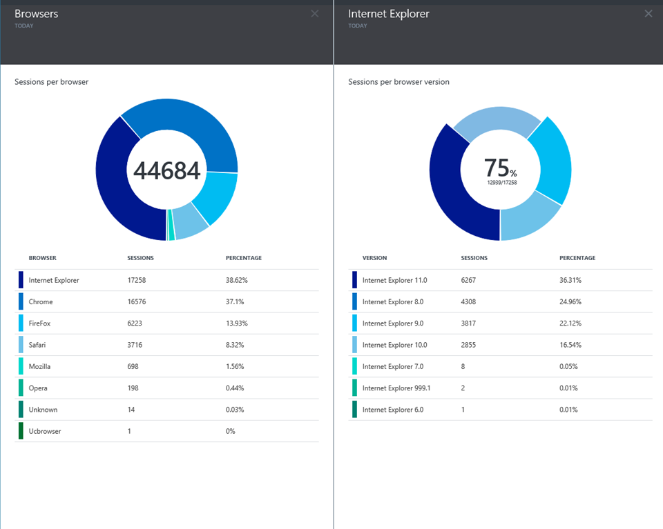
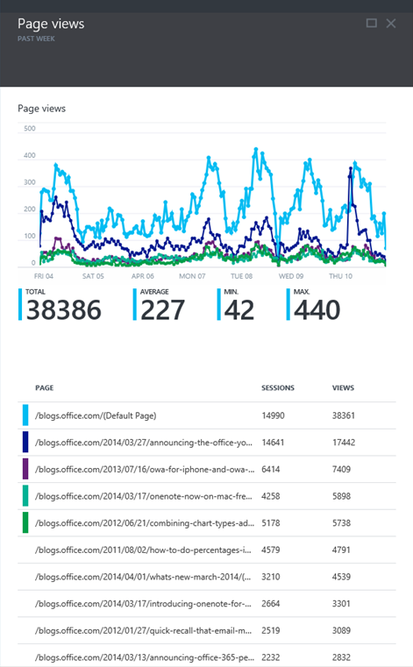
Application Insights
Application Insights

Slide 58
…and much more
Configure Custom Domain Names
Diagnostics
Deep Configurations - Kudu
Moving from Existing Sites
Remote debugging
Notes:
Diagnostics
Performance statistics
Application logging
Web server logging
IIS logs
IIS Failed Request logs
Failed Request Tracing
Kudu
Add SCM
Use the plugin "Azure Web Site Log Browser" by Amit Apple
Capturing a memory dump
Moving from Existing Sites
https://www.migratetoazure.net/
Remote debugging

Slide 59
Try App Service: Web Apps today
https://tryappservice.azure.com
Ask Questions:
Twitter:
Email
Public forum:

Slide 60
Q&A

Slide 61


Get started
Visit azure.microsoft.com

